Slide 1
Lecture 28 – Problem Reduction
CST370 – Design & Analysis of Algorithms
Dr. Byun
Computer Science

Slide 2
Lecture Objectives
After completion of this lecture, you will be able to
  explain the concept of problem reduction to solve a problem using another problem for which a solution is already known.

Slide 3
Chapter 6: Transform-and-Conquer
6.1 Presorting
6.2 Gaussian Elimination
6.3 Balanced Search Trees
6.4 Heaps and Heapsort
6.5 Horner’s Rule and Binary Exponentiation
6.6 Problem Reduction

Slide 4
Problem Reduction
A variation of transform-and-conquer algorithm.
  Transform a problem to a different problem for which an algorithm is already available.

Slide 5
Computing LCM (Least Common Multiple)
lcm(m, n): smallest integer that is divisible by both m and n.

Slide 6
Computing LCM – Middle School Approach

Slide 7
Computing LCM with the GCD algorithm

Slide 8
Exercise: Min-Heap (1 of 2)
Min-Heap
  Find the min value
  Delete the min value
  Add a number
How will you develop it using a Max-Heap?

Slide 9
Exercise: Min-Heap (2 of 2)

Slide 10
Reduction to Graph Problems
Many problems can be solved using the reduction to a graph.
Example: Peasant river-crossing problem.
  Peasant, cabbage, goat, wolf

Slide 11
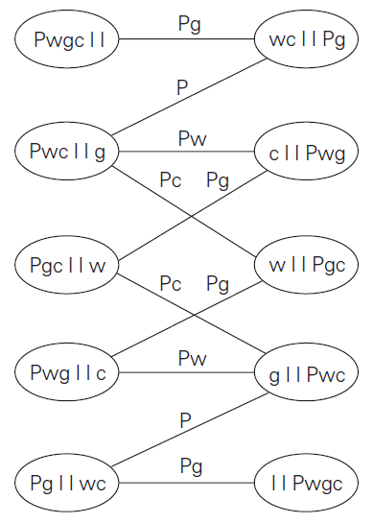
Example: State-Space Graph

Slide 12
Puzzle
There are three missionaries and three cannibals who must cross a river.
  Their boat can hold maximum two people.
  Note that missionaries cannot be outnumbered by cannibals.
  How can all six people get across the river with the fewest crossings?

Slide 13

Solution

